Slide 1
SoMe Score Evaluation
Miao & Nicola
2025/08/01

Slide 2
Goal of the work
To identify key factors that influence whether a lead will convert or not, and to develop a logistic regression model that can predict conversion likelihood to support smarter outreach decisions and improve marketing effectiveness.
Why 5 features were selected?
We applied permutation importance to evaluate each feature’s predictive power.
We computed the correlation matrix to avoid selecting highly correlated features.
The final features were chosen for being:
Statistically meaningful
Business-relevant
Non-redundant and interpretable

Slide 3
Result Summary
The total data points used is 136, true and false are evenly distributed.
The model used 5 predictors and 130 degrees of freedom left for residuals.
The Pseudo R^2 equals 0.35, indicates a moderate fit of the model to the data.
The log-likelihood is relatively low (-60), indicating a poor fit between a statistical model and the observed data.
Very low LLR p-value (8e-13) means the model fits significantly better than the null.
Notes:
Part 2: “discussion”
Highlights from the analysis - starting from the bottom of the matrix and moving up
Client facing AI opportunity ( AI Coach for Clients & AI Features for DIY Client App )
There is a high potential, but…
We expect high competition from some very strong players
Technology giants: Apple, Google
Other app providers for which the direct client app is more core: A crowded space with many health & fitness apps that has been strong market positions
We don’t see us having unique capabilities and competencies compared to many of the other players, as they have equally or more users and data than we have, and expectedly more resources - and some of them expectedly also even better competencies - to win the space
It is not that we don’t see opportunities and potential, but if we are to maximise impact on the shortest possible time, we don’t see client facing AI to be the area to prioritise the most.
Coach facing AI features
We see the option for impact being higher on Coach and KAM facing AI options, however the reason for focusing on KAMs is that…
We can control adoption at the KAMs - we can’t do that with coaches
The Commercial / KAM offering is more unique in the market vs increasing efficiency of coaches, where we are already in the top of the market
We have stronger insights, conceptualizations and beta testings, that gives us a shorter distance to making an impact
Hence, our primary focus is on doing a co-pilot to improve the commercial offering
300 coaches carry us today… we have 8-900 coaches that we haven’t developed yet. That’s our aim with our first phase of AI
So…
Our belief:
Make coaches more effective through AI
Make us more effective through AI
We constantly revisit this
Going back to Lars’ comment, I actually do believe that introducing AI as a co-pilot to KAMs could be one of part of the puzzle to make our model more scalable - and that without changing the differentiation of Lenus towards competitors
What are we building using AI:
Deep diving on our product

Slide 4
Features
Variable | Impact | P-value | Significance | Interpretation
Intercept | -3.8 | 0 | yes | Low base probability when all features are zero
days_left_in_stage | +0.187 | 0 | yes | Each extra day left in stage increases conversion odds, possibly more time gives leads more chance to convert.
followers_gained_90_pct | -1.01 | 0.48 | no | Not statistically significant but could reflect engagement potential or social proof that impacts conversion in non-linear ways.
Don’t know the coach at all | -1.19 | 0.04 | yes | Leads unfamiliar with the coach are less likely to convert
Upcoming coach | +0.66 | 0.21 | no | Not statistically significant alone but likely contributes to prediction by segmenting leads or signaling internal process variations.
Manual outreach strategy | +2.66 | 0 | yes | Strongest positive effect. Manual outreach significantly improves conversion odds.

Slide 5
Actionable Insights
Manual Outreach is powerful: Leads contacted manually are much more likely to convert. This suggests personalized, human interactions are highly effective.
Coach familiarity matters: If the lead doesn’t know the coach, their likelihood to convert drops. Consider pre-warming strategies like intros or coach branding before outreach.
Time in stage is tender: The longer a lead stays in a stage, the more likely they are to convert. Ensure follow-up mechanisms allow enough nurturing time.

Slide 6
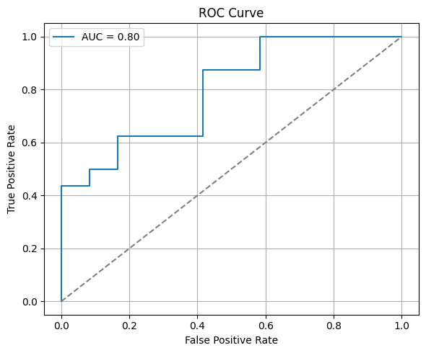
ROC & AUC Analysis
AUC Score = 0.8 which means the model distinguishes well between converted and not converted classes.

Slide 7
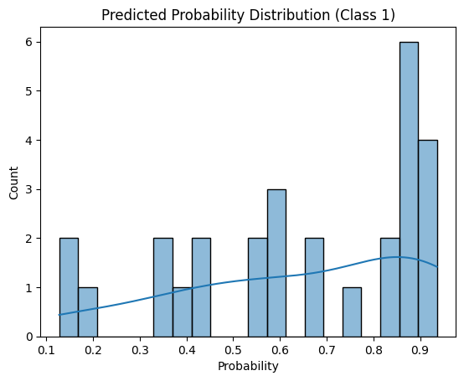
Predicted Probability Distribution
This plot shows how confident the model is when predicting lead conversions. Many predictions are close to 90%, which means the model often gives strong signals about which leads are most likely to convert. We can use these scores to focus our sales or outreach efforts more effectively.

Slide 8
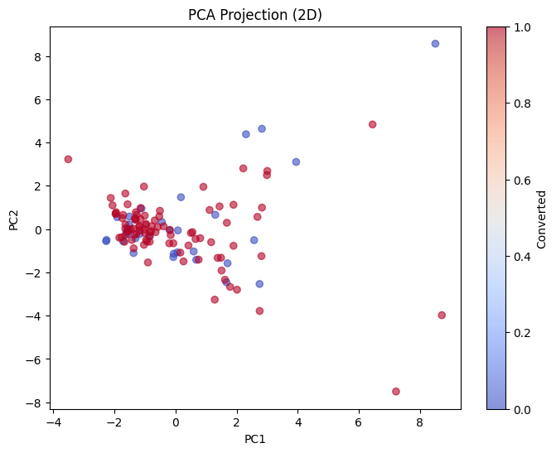
Principal Components Analysis
Possible business insights:
Leads have similar behaviors
Conversion might depend on specific, distinct attributes rather than the most common ones
Outlier leads with unique patterns might be high-conversion targets worth investigating

Slide 9
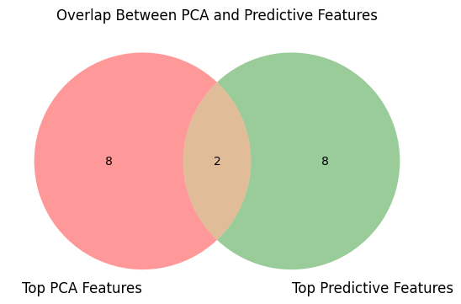
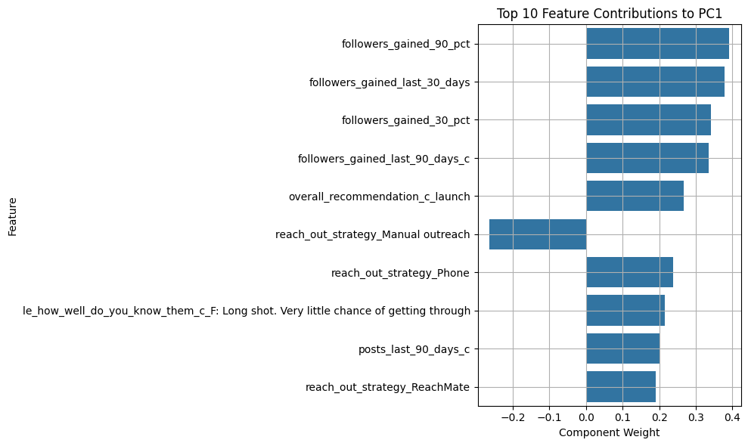
Components First Guess from PCA

Slide 10
Features for Future Investigation
Statistical significant features:
Days_left_in_stage
Don’t know the coach at all
Manual outreach strategy
Informational rich:
coach_persona_Fitness/Beauty influencer coach
Days_left_in_stage
main_selling_points_Time: Efficiency & Ease
Posts_last_90_days
Overlap features:
Followers_gained_90_days_percentage
Manual outreach
posts_last_90_days

